Slide 1
The Regiomontanus Problem in 3D
Austin Holt
George Chemmala

Slide 2
“A painting hangs from a wall. Given the heights of the top and bottom of the painting above the viewer's eye level, how far from the wall should the viewer stand in order to maximize the angle subtended by the painting and whose vertex is at the viewer's eye?”
– Regiomontanus

Slide 3
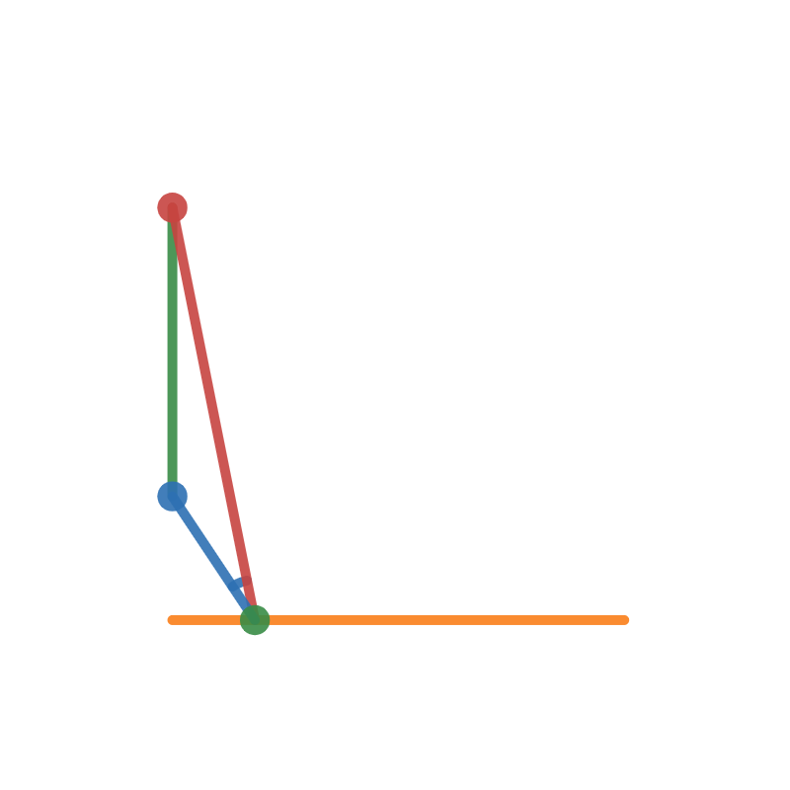
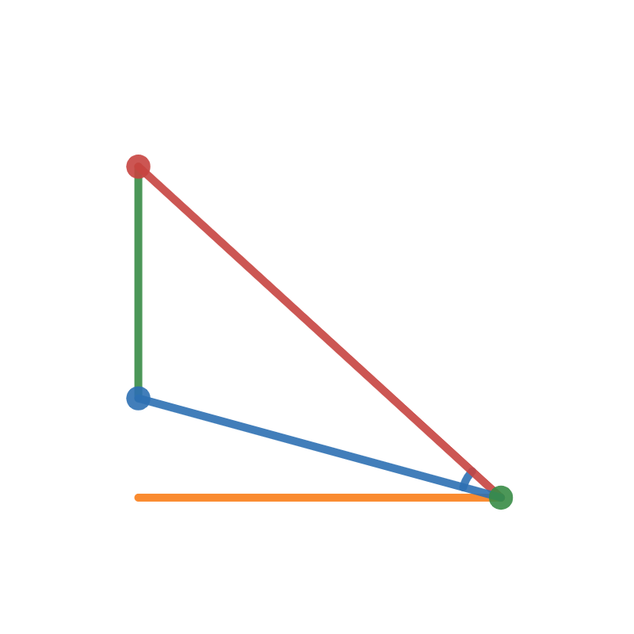
Too Close
Too Far

Slide 4
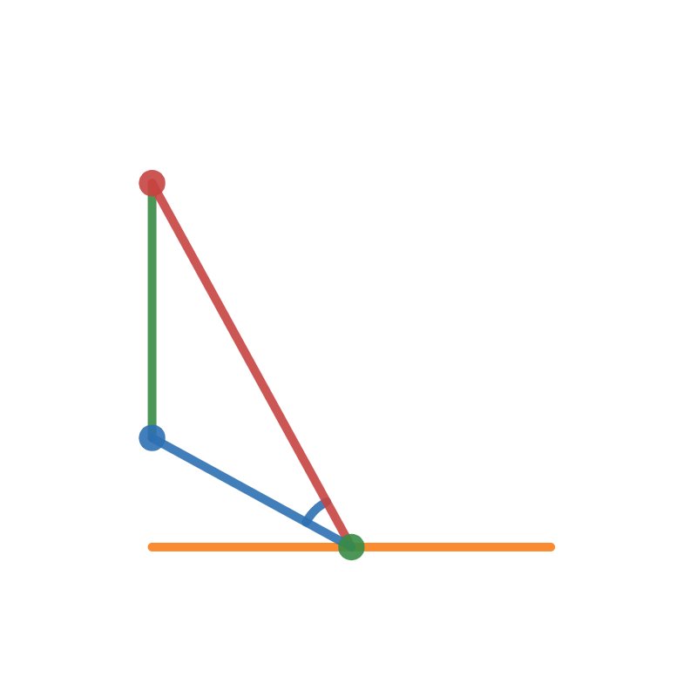
Optimal

Slide 5
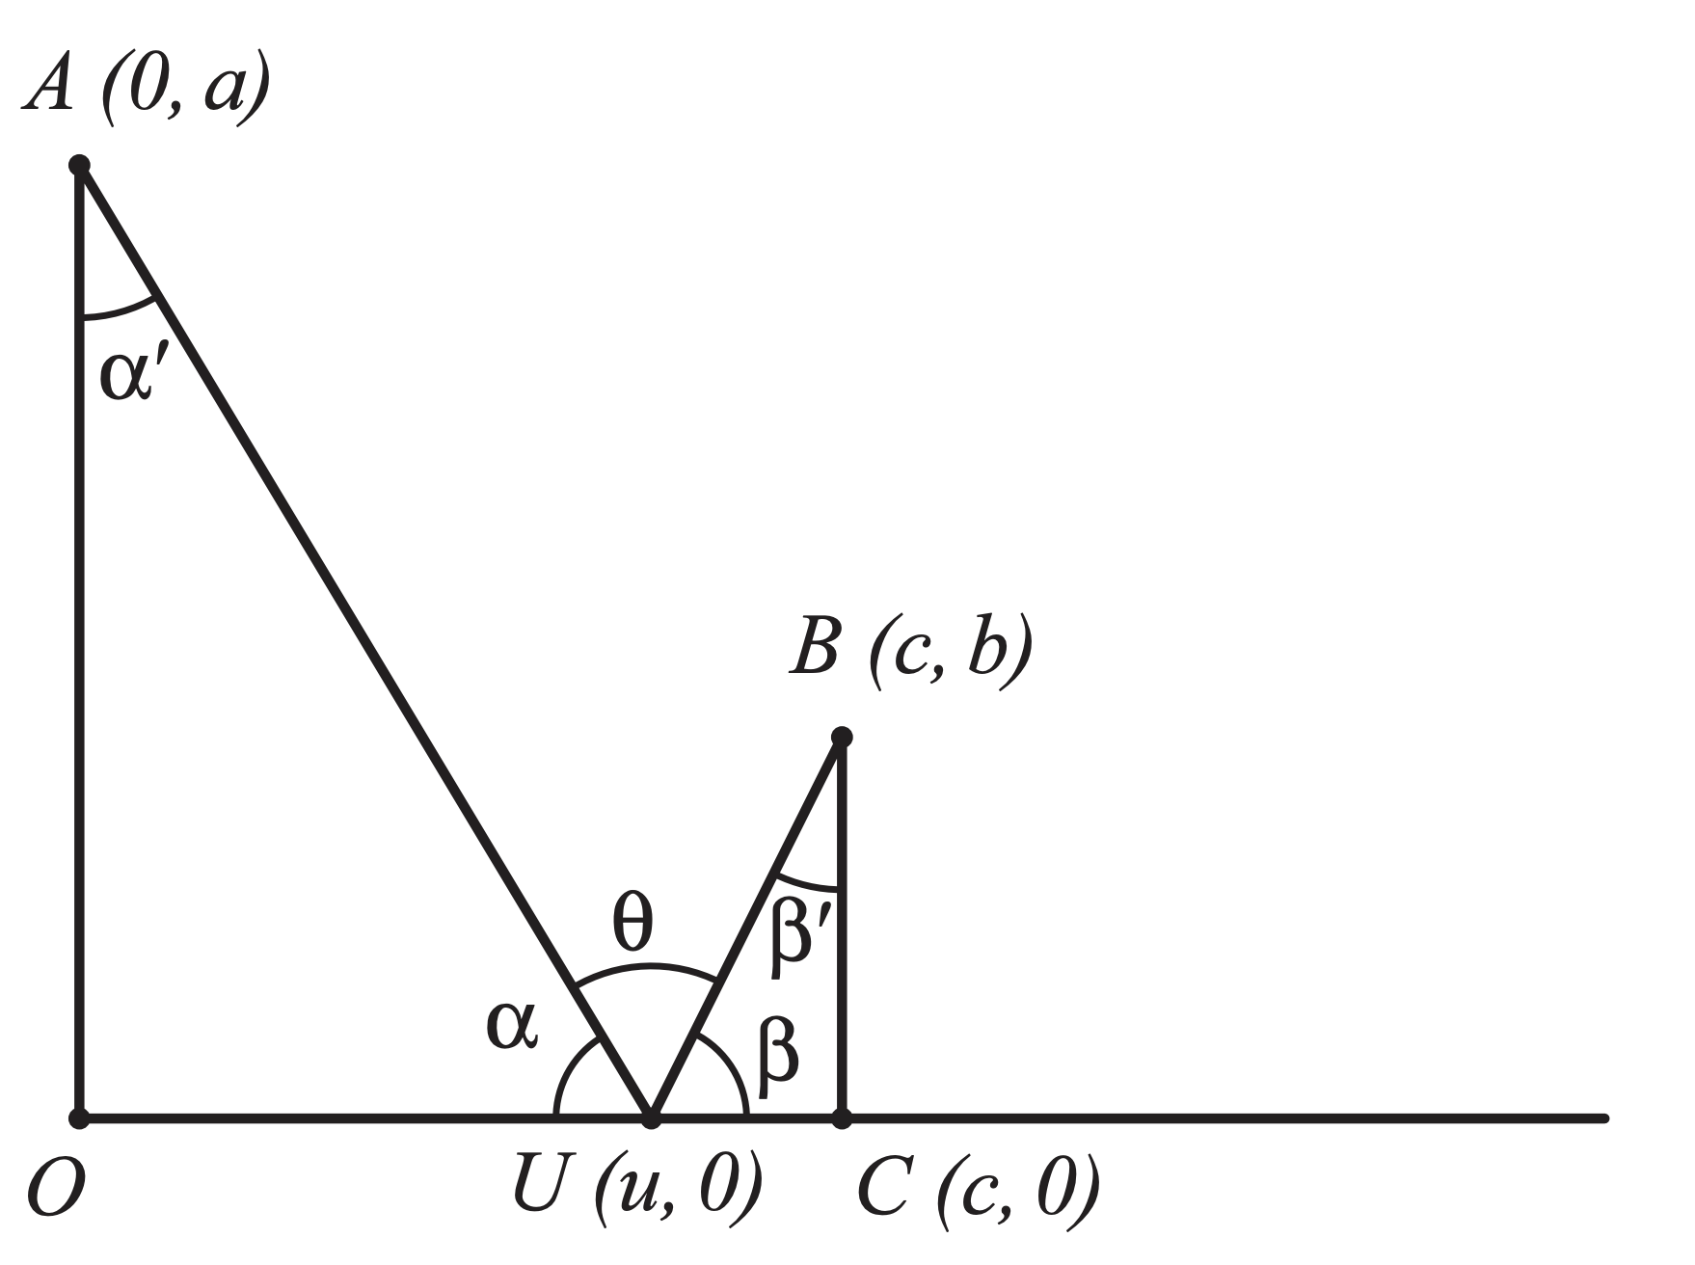
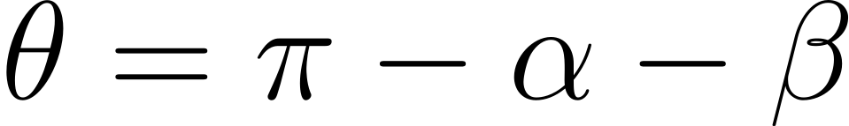
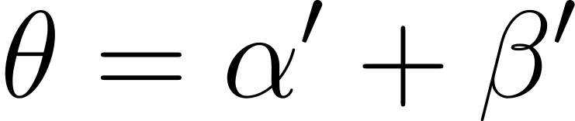
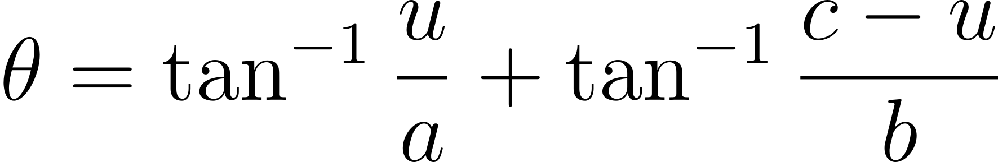

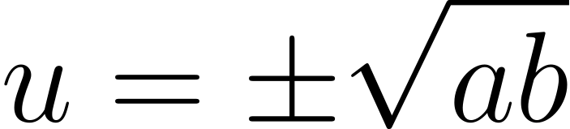

Solving by Calculus
$$…$$

Slide 6
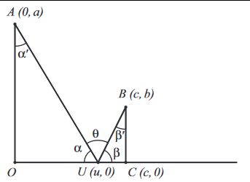
Solving by Calculus
\theta=\pi-\alpha-\beta
\theta=\alpha^{\prime}+\beta^{\prime}
\theta=\tan ^{-1} \frac{u}{a}+\tan ^{-1} \frac{c-u}{b}
…
u=\pm \sqrt{a b}

Slide 7
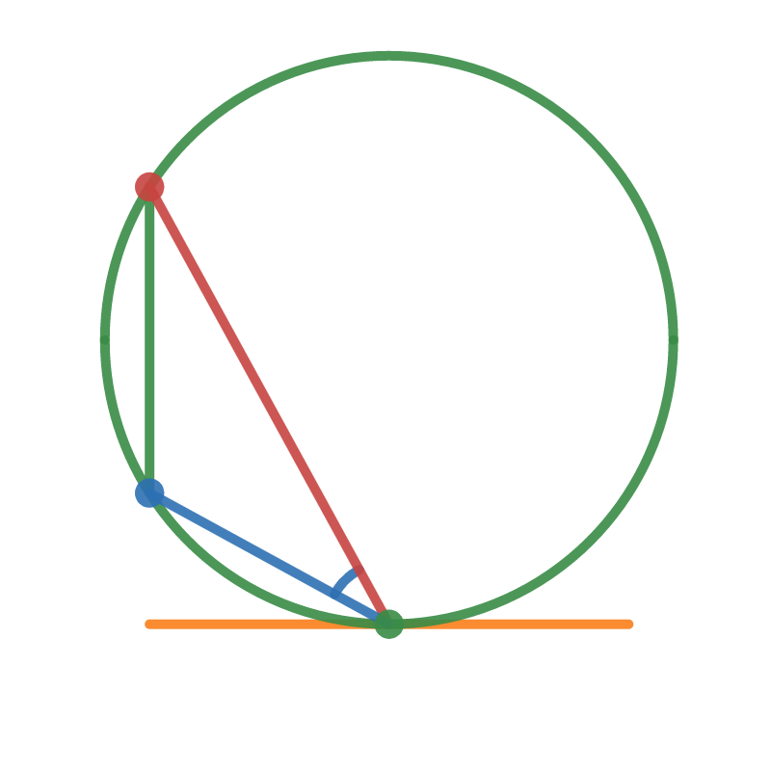
By Geometry

Slide 8
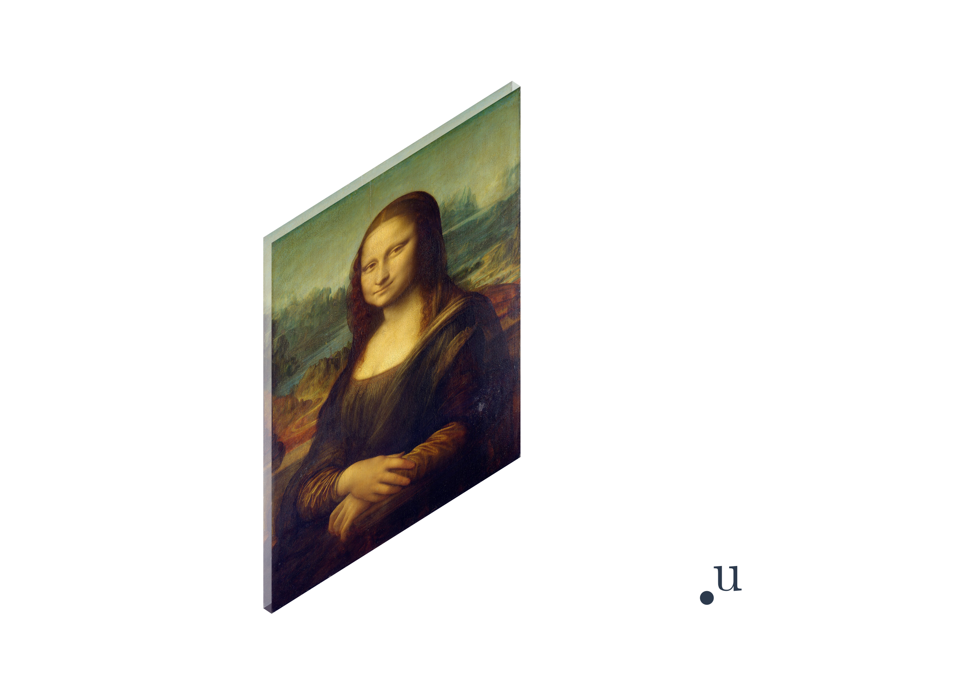

Slide 9
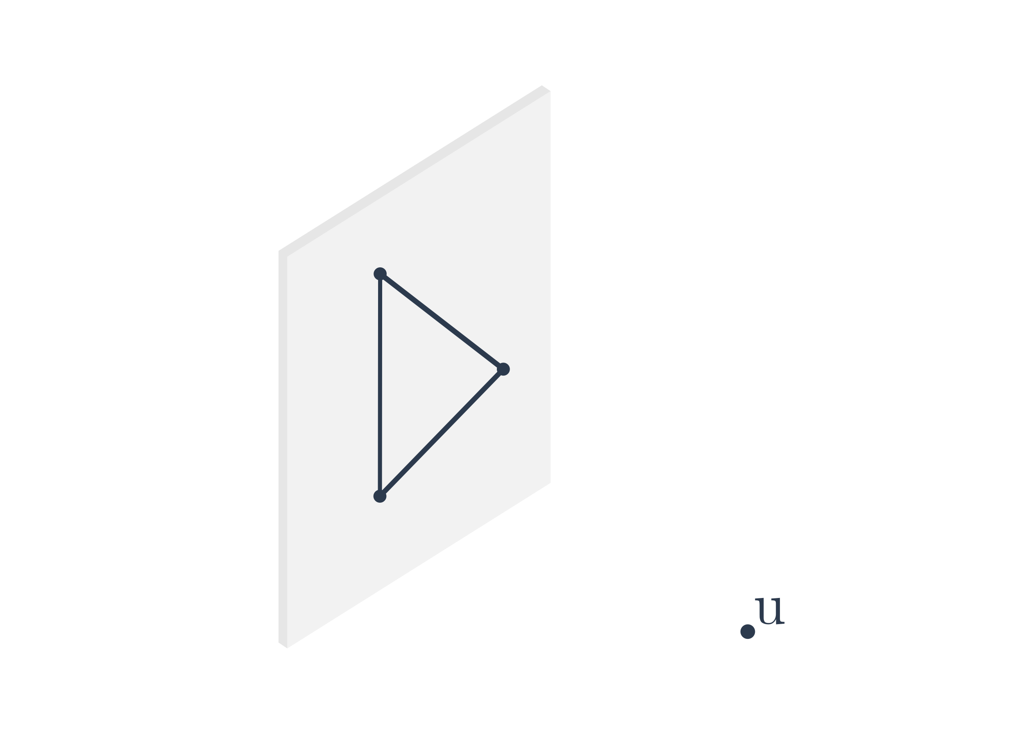

Slide 10
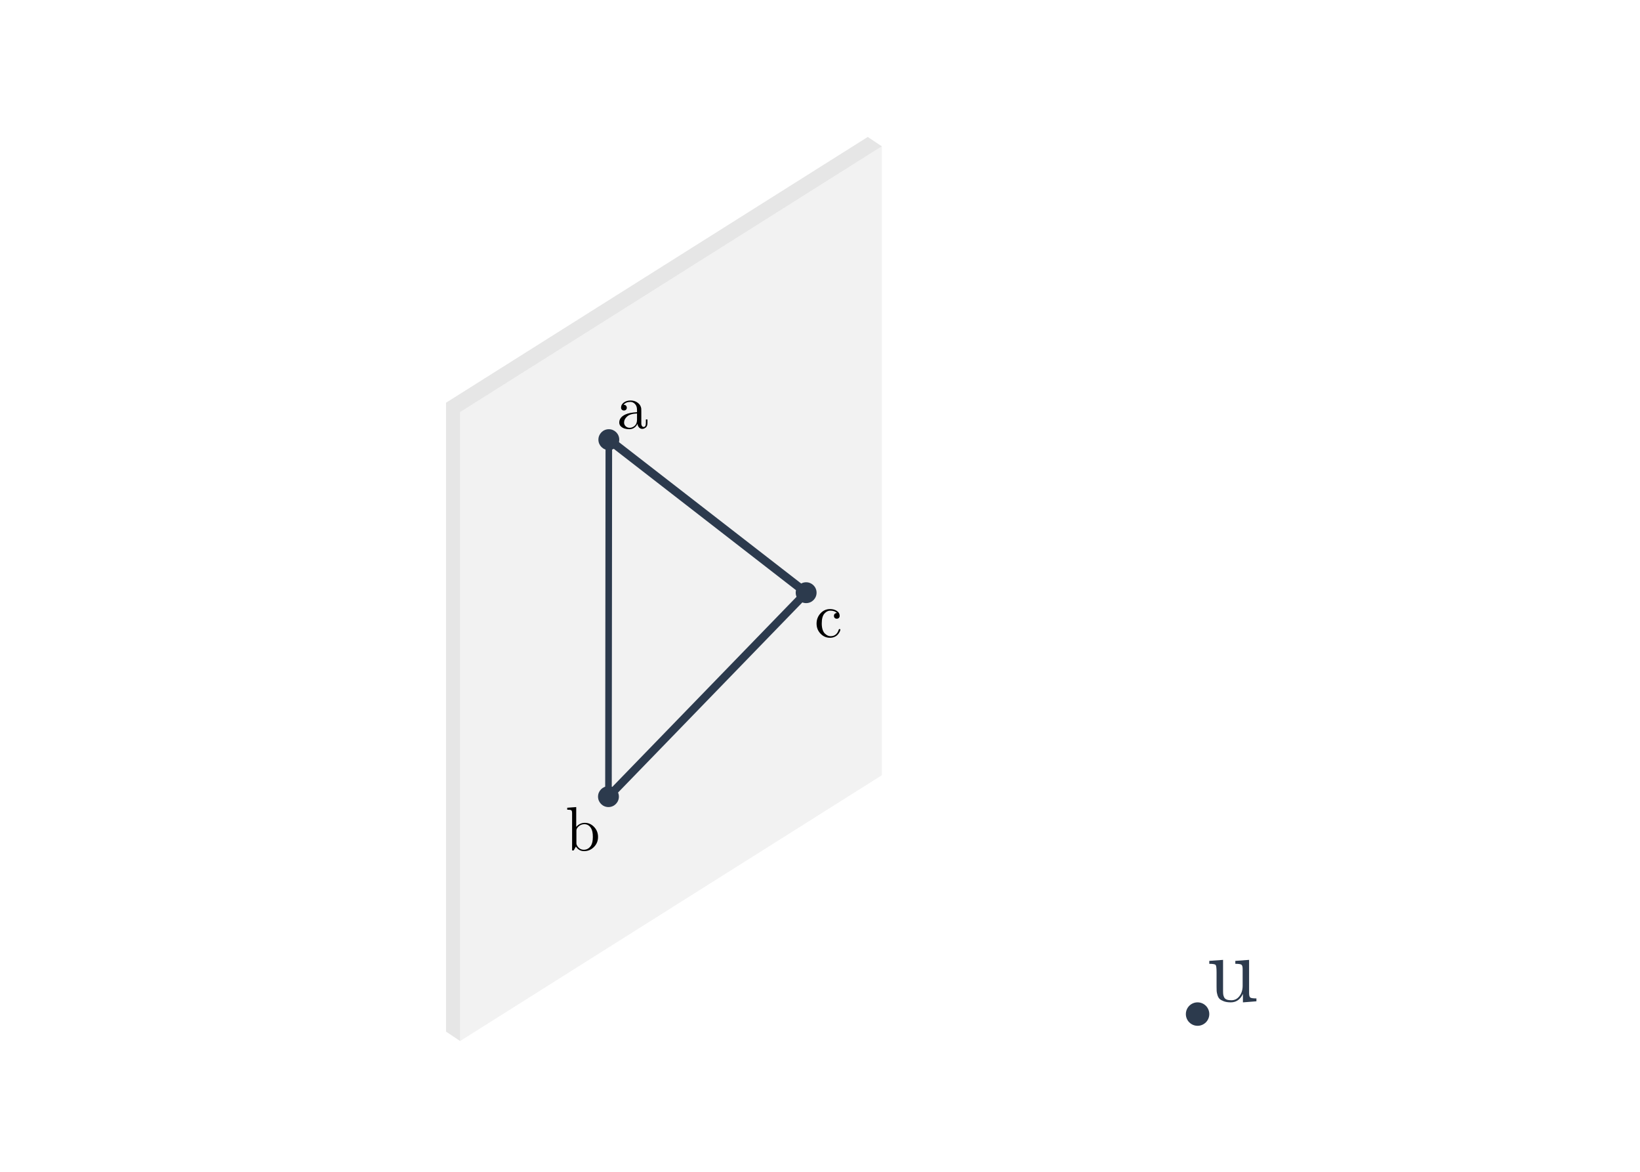

Slide 12
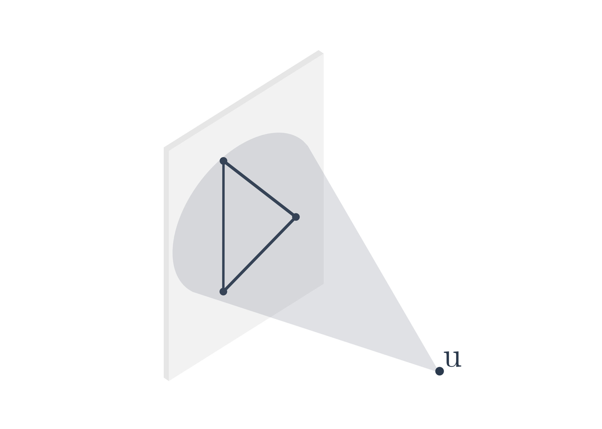
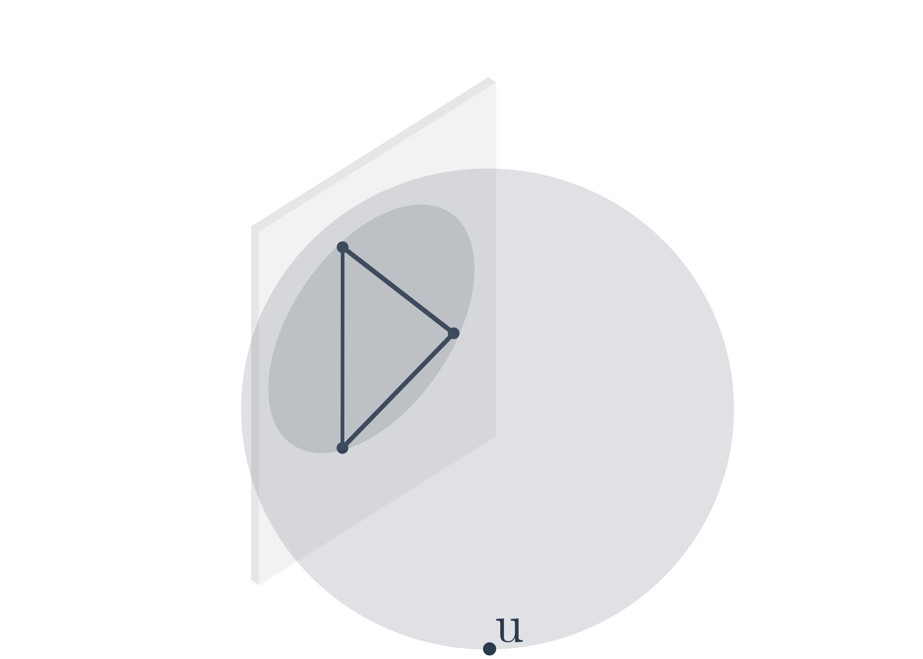
Cone
Sphere

Slide 13
Cone Method
Definition of angle
Based on smallest surrounding cone
Angle based on 2D cross sections
Horizontal and vertical components
Angles summed for total
a
c
b

Slide 14
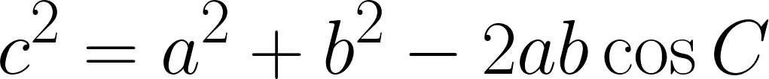
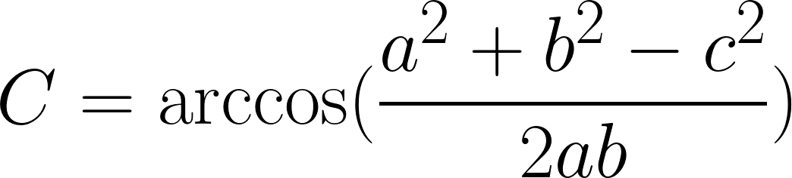
Cone Method cont.
Law of Cosines
Rearrange for C
c
a
b
C

Slide 15
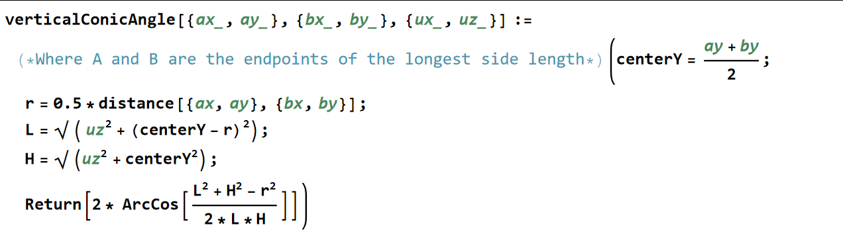

Cone Method cont.
centerY
H
r
L
2𝛉
𝛉
U (0, u_{z})

Slide 16
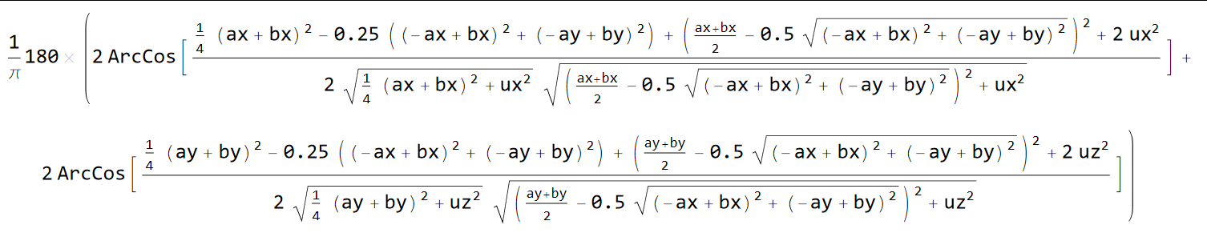
Cone Method cont.

Slide 17
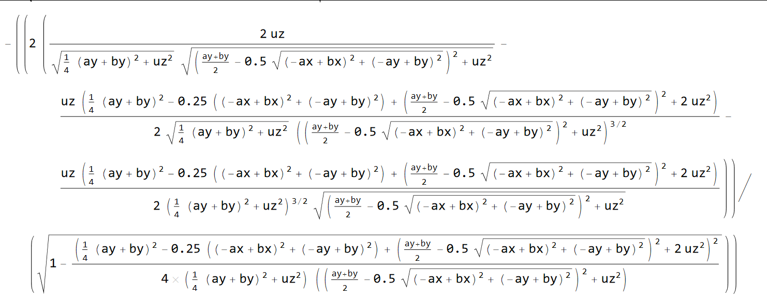

Cone Method cont.

Slide 18

2D Geometric Solution
A (0,a)
O ($\sqrt{ab}$,$\frac{a+b}{2}$)
B (0,b)

Slide 19
Extension of 2D Geometric Solution
2D Geometric Solution:
3D Geometric Solution
Circle defined by 2 points and a radius
Sphere defined by 3 points and a radius
?

Slide 20
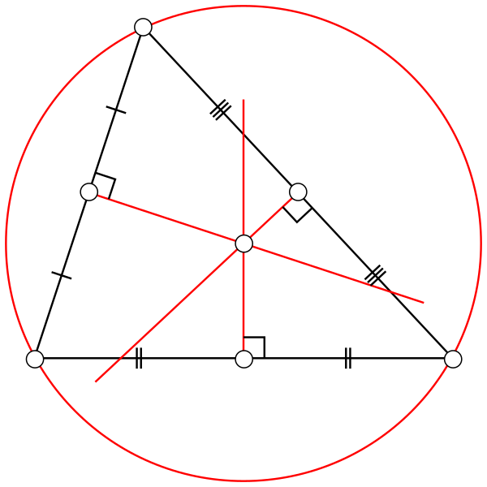
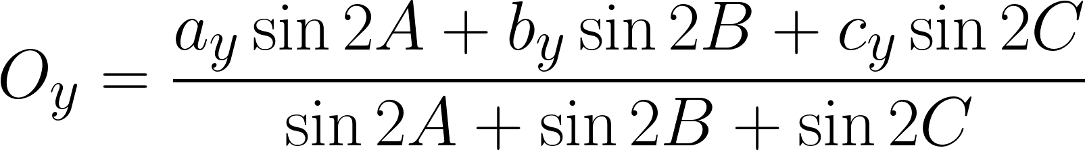
Circumcenter

Slide 21
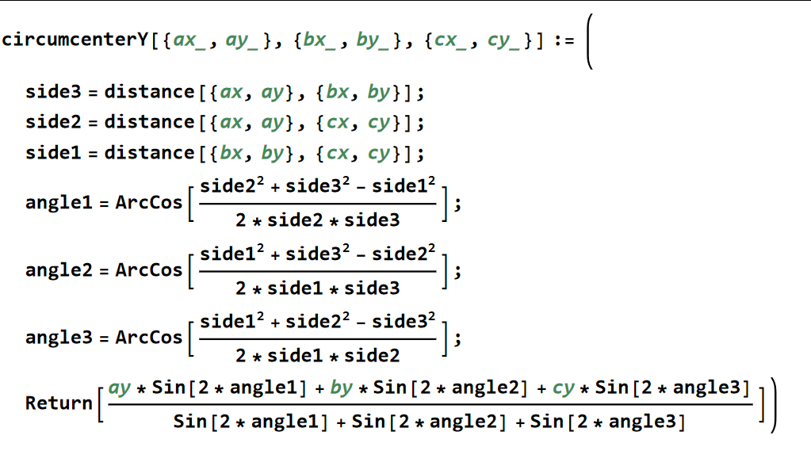
Circumcenter cont.

Slide 22
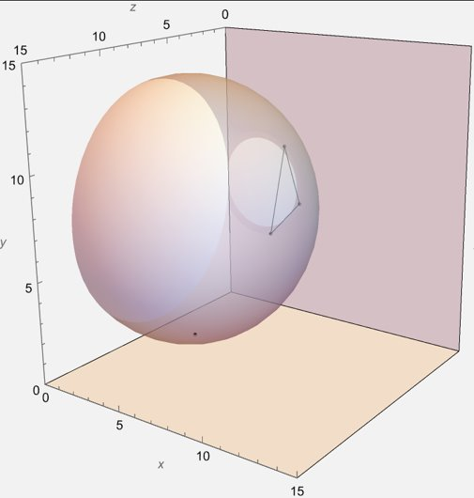
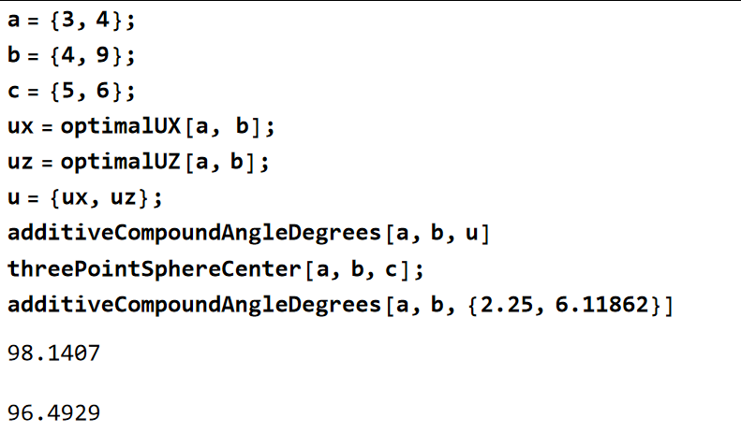
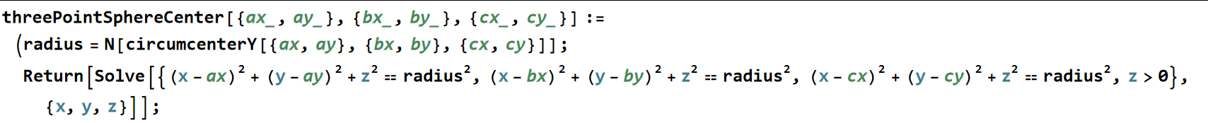
Sphere Mehod

Slide 23
Further Discussion
Alternate angle definitions
True double-angle
Spherical projection
u

